Slide 1
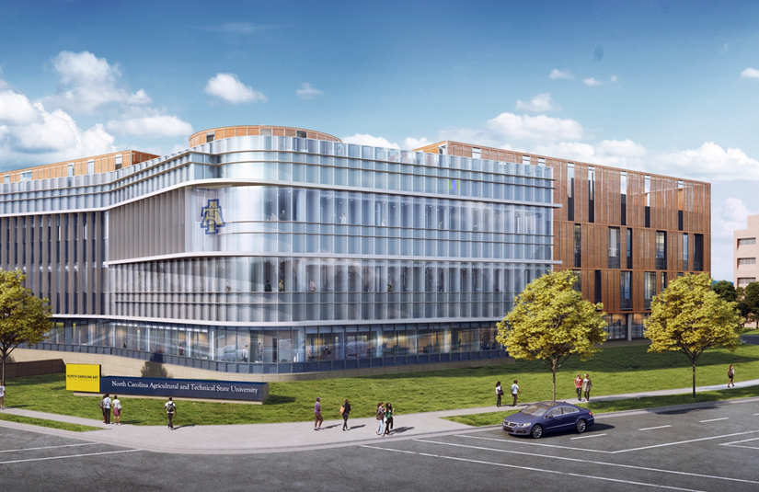
Economic impact of north Carolina a&t state university
Drs. Alfredo Romero & Cephas Naanwaab
Associate Professors of Economics
A Presentation to the Media
08/10/2023

Slide 2

Background of the economic impact study
BACKGROUND
This study was commissioned by Dr. Tonya Smith-Jackson, Provost and Executive Vice Chancellor for Academic Affairs
It assesses the economic impact of North Carolina A&T State University in FY 2022
Last economic impact of the university was conducted in 2018
The study was designed to measure and quantify the economic impact of the University statewide, within Guilford, and PTA

Slide 3
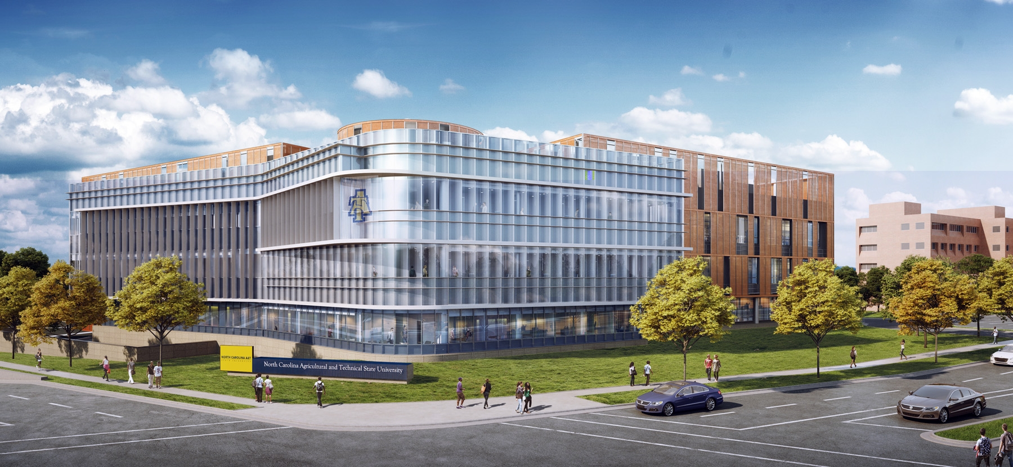
The Economic Impact Study
Methodology

Slide 4
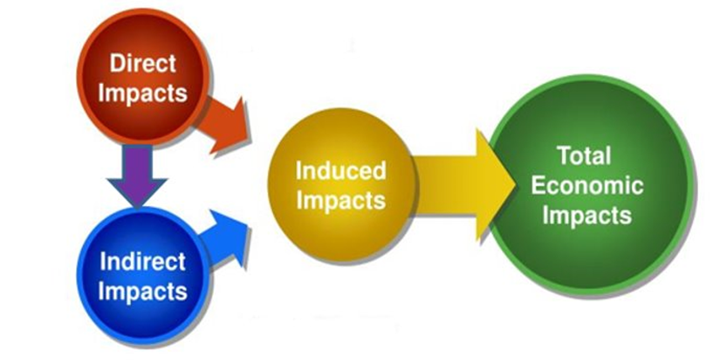
What is an Economic impact study?
Definitions
A schematic representation
Direct, Indirect, and Induced Impacts
Each dollar spent generates an immediate or direct demand for goods and services (Direct impact)
The initial spending reverberates through the economy, creating a multiplier effect, or additional impacts (Indirect and Induced impacts)

Slide 5
The Implan model
IMPLAN Modeling
From inputs to outputs: multipliers
IMPLAN is the leading I-O model for conducting economic impact analyses
IMPLAN multipliers are based on the Bureau of Economic Analysis benchmark I-O tables
IMPLAN's 546 industries (based on NAICS coding) are the most comprehensive, comprising nearly all sectors of the economy
The IMPLAN model contains multipliers, reflecting spending patterns in each industry
Multipliers describe how a $1 spending in a particular industry generates impacts in the overall economy

Slide 6
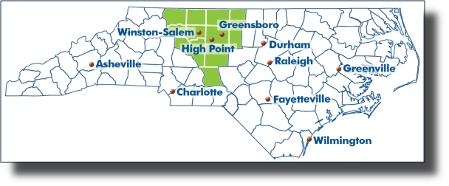
Economic Impact Study areas
Study Area
The study assessed the economic impact of N.C. A&T on:
The State of North Carolina
Guilford County
The 12-county Piedmont Triad Area

Slide 7
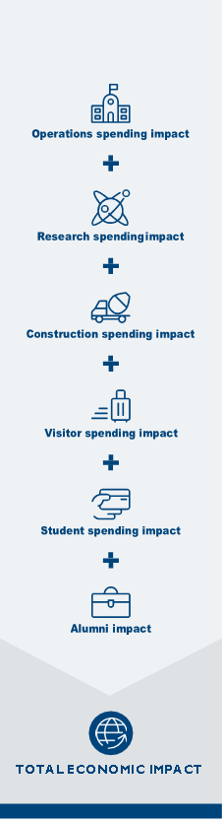
The Implan modeling process
Data
We assessed the economic impacts of the following categories of spending
Operational spending by the university for wages and salaries, procurement of materials & supplies, utilities, etc.
Research spending by the university
Spending by undergraduate/graduate students
Spending by visitors to the university for athletics events, commencements, and homecoming
Capital spending
Alumni spending

Slide 8
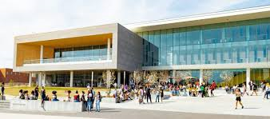
Economic impact results

Slide 9
Total Economic Impact of NC A&T, FY 2022
Results
University’s operations, spending by employees, students, visitors, & alumni generate…
Category | Employment | Labor Income (thousands) | Value Added (thousands) | Output (thousands)
Operations | 7,163 | $295,082 | $440,099 | $744,200
Research spending | 783 | $56,725 | $85,626 | $157,409
Student spending | 1,576 | $44,289 | $118,876 | $178,400
Capital spending | 488 | $31,814 | $45,621 | $79,634
Visitor spending | 368 | $14,819 | $23,996 | $43,952
Alumni spending | 6,959 | $376,259 | $701,945 | $1,209,192
Total Impact | 17,337 | $818,989 | $1,416,163 | $2,412,787

Slide 10
Impacts by Geographic area
Results
Category | Guilford County Impact | Piedmont Triad Impact | Statewide Impact
Employment | 10,200 | 11,643 | 17,337
Labor Income (thousands) | $428,896 | $502,737 | $818,989
Value Added (thousands) | $692,887 | $826,816 | $1,416,163
Output (thousands) | $1,157,524 | $1,397,717 | $2,412,787

Slide 11


