Slide 1
Reopening of campus
Harold L. Martin, Sr.
Chancellor
Virtual Town Hall
06/03/20

Slide 2
Campus safety
Robert Pompey
Vice Chancellor, Business and Finance
Virtual Town Hall
06/03/20

Slide 3
Cleaning & sanitizing
Cleaning & Sanitizing
Facilities team reported to work on June 1, 2020 to begin cleaning and sanitation efforts
Clean in accordance with CDC guidelines which includes a deep cleaning of all buildings
Utilize registered EPA disinfectant products that meet criteria for use against the COVID-19
All personnel will use gloves and face coverings, especially when social distancing is not possible

Slide 4
Cleaning & sanitizing
Campus Safety
Perform cleaning of all areas each morning and routine cleaning of frequently touched surfaces, including tables, doorknobs, light switches, countertops, handles, desks, elevator buttons, keyboards, toilets, faucets, sinks, etc.
Supplement current personnel with contracted service companies and temporary personnel to address the additional effort required to clean high touch services
Provide hand sanitizer dispensers and disinfecting wipe dispensers will be located outside of classrooms, conference rooms and other high traffic areas, providing faculty, staff, and students the opportunity to sanitize the instruction and seating areas prior to the beginning of classes and meetings, respectively

Slide 5
Cleaning & sanitizing
Campus Safety
Cleaning supplies will be made available to individual departments and areas
Facilities leadership team will meet with administrators to discuss the following:
  Cleaning protocol
  Plexiglass ;location in reception areas
  Concerns and questions

Slide 6
Social Distancing
Campus Safety
All students, faculty, and staff are expected to maintain six feet of social distancing at all times. This includes the classroom, offices, and all other spaces.
Class rooms, conference rooms, auditoriums, stadiums, etc. will be configured to promote social distancing
Directional signage will be posted to promote one way paths where practical
For areas that will have lines, place visual cues that indicate where to stand

Slide 7
Social Distancing
Campus Safety
To reduce the density on our campus, departments are encouraged to continue to consider options such as:
  Remote Work
  Alternating Days
  Staggered Reporting/Departing
Use the steps, when possible; no more than 2 people should be in an elevator at one time
Plexiglass will be placed in high traffic reception areas
Recommend the continuation of virtual meetings
Please contact Facilities with requests to review work environments where social distancing is a challenge

Slide 8
Personal protective equipment (ppe)
Campus Safety
Face coverings are critical in minimizing the risk to others.
The university strongly encourages employees to wear masks or face coverings when working on campus and unable to maintain social distancing measures as described above.
Students, faculty, and staff should bring their own face coverings; however the university will supply an A&T branded cloth face covering to all students, faculty, and staff during the fall reopening
The University also has a supply of disposable face coverings that will be made available to colleges and departments, as needed.

Slide 9
questions

Slide 10
Returning to campus
Erickia Elbert
Interim Vice Chancellor, Human Resources
Virtual Town Hall
06/03/20

Slide 11
Target dates
Returning to Campus
Phase 1: May 8 – 30
Phase 2: June 1 – 19
Phase 2: Start no earlier than June 22, 2020
Phase 3: Start no earlier than July 13, 2020
Phase 4: Start no earlier than August 3, 2020

Slide 12
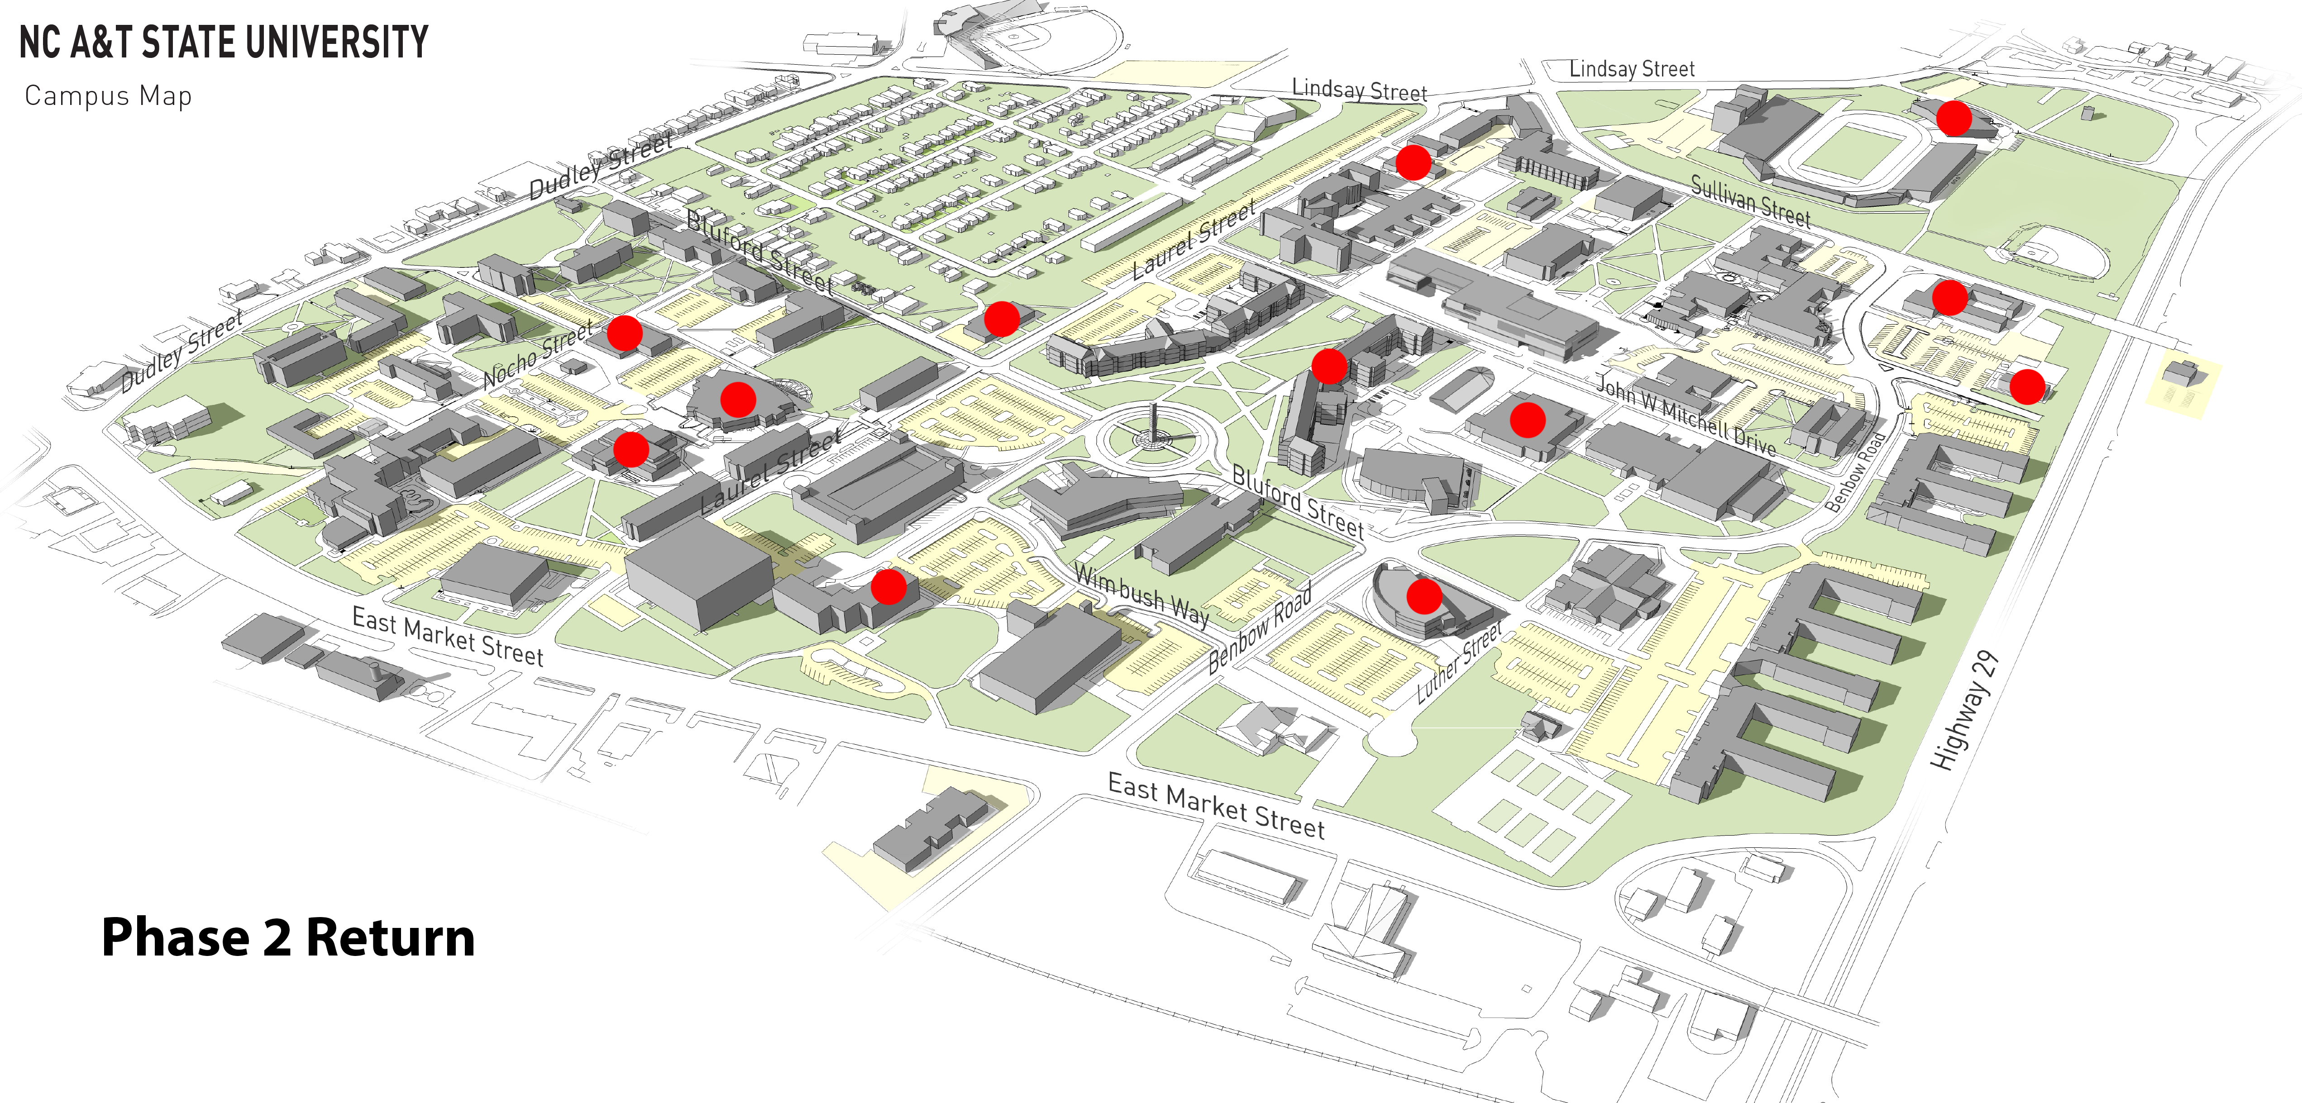
Returning to Campus
Buildings Open on Campus
Phase 2 Groups on Campus
June 1
Facilities Operations
Housekeeping
Grounds
Employees on Campus
80%
Teleworking
Phase 2 Groups on Campus
No later than June 22
20%
On Campus
Executive Leadership Team
Sr. Leadership
Other Departments
Should continue to telework, stagger work schedules
(workdays, start times, work hours)

Slide 13
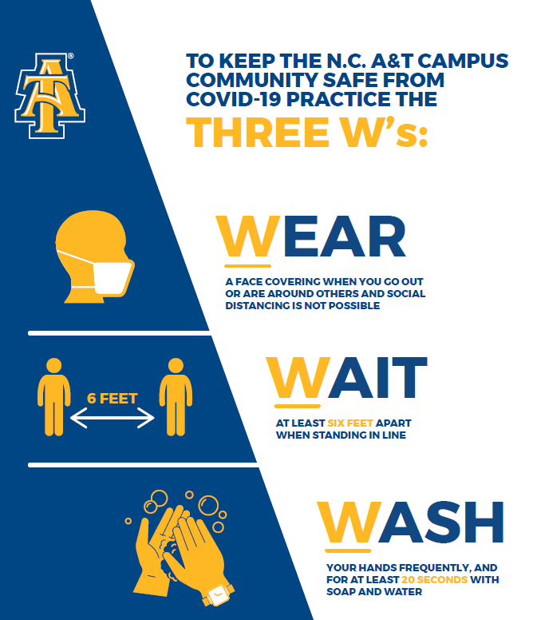
Transition back to Campus
Returning to Campus
Your Safety (Guidelines To Returning Back To Campus)
PPE/Cleaning Building
Self-Monitoring
Managers Orientation
EH&S Safety Training
COVID-19 Faculty and Staff Work and Leave Provisions
  Families First Coronavirus Response Act (FFCRA) Leave
  High Risk and Care Guidance

Slide 14
Transition back to Campus
Returning to Campus
COVID-19 Guidelines For Returning To The Workplace
Mental And Emotional Well-being
  EAP (ComPsych)
  NCAT Counseling Services: (336)334-7727
  Setup Email For Concerns And Feedback
  Human Resources COVID-19 Website

Slide 15
questions

Slide 16
Course delivery
Beryl McEwen
Provost and Executive Vice Chancellor, Academic Affairs
Virtual Town Hall
06/03/20

Slide 17


On campus instruction
Course Delivery
Face-to-face
  Smaller class sizes for physical distancing
  Mask during classes
  Entrances and exits separated
  Professors encouraged to limit roaming
Hybrid
  Blend of face-to-face and online/remote delivery
  Access to professors at least once per week

Slide 18
Distance education
Course Delivery
Online
  Fully asynchronous
  Synchronous elements
  Remote Advising
  Remote Access to all campus services
  Library
  Accessibility Resources
  Writing Center
  Tutoring
  Counseling

Slide 19
research
Eric Muth
Vice Chancellor, Research and Economic Development
Virtual Town Hall
06/03/20

Slide 20
Returning to research: a phased approach
Research
Phase 1 – Situation unknown and changing, “Stay at Home” order in effect
  Only maintenance activities allowed
  Researchers must be designated as mandatory employees to be on site
Phase 2a – Social distancing relaxed, “Safer at Home” order in effect
  On campus access allowed to maintain research capability or prevent catastrophic disruption
  COVID-19 related research encouraged
  Paused and ongoing time-sensitive research slowly allowed to resume or continue
  Preparations to prepare for next phase including purchasing of necessary supplies and putting safety measures in place

Slide 21
Returning to research: a phased approach
Research
Phase 2b – Further relaxation of restrictions – standards for return to normal
  Gradually expand # of people on campus while maintaining social distancing (in the following order: faculty, research staff post-docs, graduate students, undergraduate students)
  Time-sensitive new on-campus research allowed, with social distancing. All research that can be done remotely should continue to be, including all seminars, group meetings, etc.
Phase 3 – No or minimal state restrictions
  All types of on-site research allowed

Slide 22
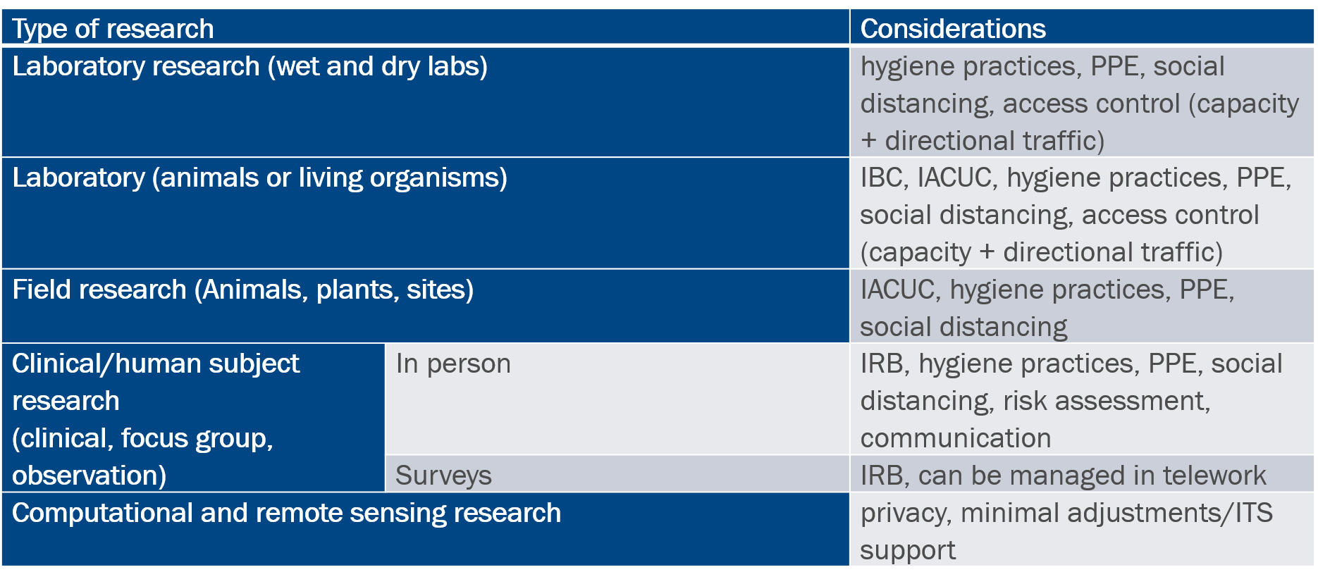
Consideration before returning to research
Research

Slide 23
questions

Slide 24
Student affairs
Dr. Melody Pierce
Vice Chancellor, Student Affairs
Virtual Town Hall
06/03/20

Slide 25
Housing and residence Life
Student Affairs
We will implement a tiered move-in process for select student groups. Each group will have a designated date and time:
  >Special Populations: June 24th through August 6th
  >New Students: August 7th through 9th
  >Continuing Students: August 14th through 18th
All residence halls will receive thorough cleaning 7 days per week, multiple times per day.
Students residing together as roommates are considered a “family unit” and will be expected to practice the proper precautions to maintain a healthy environment (3 Ws).

Slide 26
Housing and residence Life
Student Affairs
Visitation for the Fall 2020 semester is restricted and common area (lobbies, study rooms, computer labs, laundry facilities, etc.) capacities within residence halls will be limited.
Residence hall expectations will be communicated with each student upon arrival during a series of virtual residence hall meetings facilitated by Housing and Residence Life staff members.
A location has been identified for quarantine use, if a student presents symptoms. Students are expected to relocate to this area during testing. Students testing positive are expected to return to their permanent home address as soon as possible. The quarantine area will be sanitized multiple times a day on a weekly schedule.

Slide 27
DINING and retail operations
Student Affairs
Seating capacities in dining facilities will be reduced to 50% of the maximum occupancy across campus.
Dining areas will align with physical distancing guidelines including limited seating, six-feet spacing, adjusted flows of traffic, to-go options, contactless and touchless payment options, and restricting self-serve options.
We will expand sanitation measures in all locations and provide additional cleaning services between meal hours.

Slide 28
Student Affairs
STUDENT CENTER AND CAMPUS RECREATION CENTER
In collaboration with Dining Services, the Student Center will modify hours of operation:
>Monday-Friday: 8am-10pm
>Saturday: 12pm-10pm
>Sunday: 2pm-10pm
Flow of traffic will be adjusted to align with physical distancing guidelines and signage will be placed in highly visible locations throughout the building.
Extensive cleaning and disinfectant measures will be implemented with hourly sanitation throughout the facility.
External individual and group event reservations are restricted for the Fall 2020 semester.
Capacities for internal events will be limited and room layouts will reflect physical distancing guidelines at all times.

Slide 29
Student Affairs
STUDENT engagement
Students will have access to virtual “return to campus trainings”. The trainings will include guidelines for maintaining a healthy environment.
Students are expected to review training materials prior to arrival on campus.
We will restrict large gatherings for the Fall 2020 semester and only permit gatherings of 10 indoors or 25 outdoors.
Events larger than the aforementioned should transition to an online format or postpone to Spring 2021 (i.e. Greek life activities, socials, comedy show, etc.)
Students are expected to follow physical distancing guidelines for all social gatherings.
Use of Greek plots is permitted, with the expectation of physical distancing and use of masks.

Slide 30
questions

Slide 31
athletics
Earl Hilton
Director, Intercollegiate Athletics
Virtual Town Hall
06/03/20

Slide 32
Athletics
Why?
How?
- Guidelines for students generally
- NCAA guidance
- Testing
- Conditioning / Practice
- Calendar

Slide 33
Athletics
Football – Game Day
Health and Safety
- Social Distancing and Masks
- Ingress / Egress
- Tailgating
- Concessions
- Tents / Beer Garden
- Skybox

Slide 34
questions

Slide 35
Budget impact
Robert Pompey
Vice Chancellor, Business and Finance
Virtual Town Hall
06/03/20

Slide 36
Budget Impact goals
Budget Impact
Assess the Financial Impact of the following:
  Method of Education Delivery
  State of the Economy
Investments Needed to have a successful Fall 2020 Opening
Maximize Recruitment and Retention
Maintain the Financial Viability of all Aspects of the University

Slide 37
POTENTIAL Budget Impact
Budget Impact
Full- Time Distance Education Students pays 18% less than In-Class Full time Students in tuition
Distance Education Students don’t pay Athletics, Health Services, Debt Service Fees or Student Activities Fees
Distance Students, if they elect to stay home would not be in Residence Halls or have Meal Plans
Accordingly, tuition and fee revenues in all of these areas will be adversely in the Fall 2020
Potential Impact - $22 million to $26 million

Slide 38
State of the Economy
Budget Impact
COVID-19 has significantly impacted the economy
Projected Unemployment rate was 15% in April 2020, up from less than 4%, prior to the pandemic
The State of NC derives it revenues from income taxes, sales taxes, etc.
The downturn has adversely impacted State revenues, resulting in the need to implement budget reduction measures Statewide
The University is reviewing budget reduction scenarios at 5% and 10%
Potential impact - $4.5 to $9 million

Slide 39
Investments needed for the fall 2020
Budget Impact
With the increase in Distance Learning, there will be a need to develop classes that will allow students the opportunity to maximize distance learning
Additionally, cleaning and safety measures, as discussed previously, will be implemented
IT support will also be required to support distance education and other efforts
Anticipated support needed - $6 Million

Slide 40
CARES ACT FUNDING
Budget Impact
The University will receive $44 million in CARES Act Funding
Of this total, approximately $16 million has been dispersed in the form of housing and dining refunds and emergency grants to the students
The remaining $28 million will be utilized to provide student support and support investments needed for the Fall of ($6 million), provide stabilization funding for areas impacted by the shortfall from distance learning ($22 million to $26 million) ,and provide support for the potential appropriation loss from the budget shortfall (4.5 million to $9 million).

Slide 41
NEXT STEPS
Budget Impact
Obtain the final budget reduction from the General Assembly
Finalize the investments needed for Fall 2020
Implement budget reductions
Allocate CARES Act funding for student support and operations

Slide 42
questions

Slide 43
Open discussion
Harold L. Martin, Sr.
Chancellor
Virtual Town Hall
06/03/20

Slide 44
Thank you

