Slide 1

Construction, New Degrees, Development
North Carolina A&T, 2023-24:
The Exciting Year Ahead
Media Availability
Chancellor Harold L. Martin, Sr.
August 23, 2023

Slide 2


Construction:
Select Projects

Slide 3
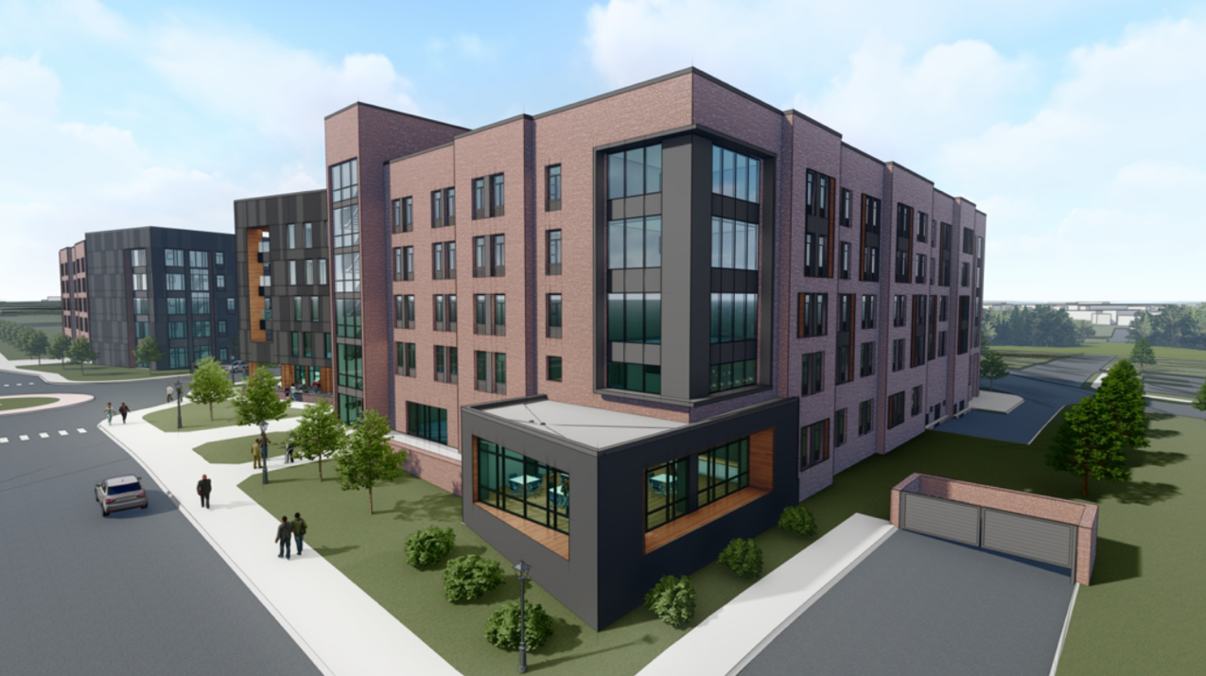
Exciting Year Ahead
Main Campus
Bluford
Street
Residential
Complex

Slide 4
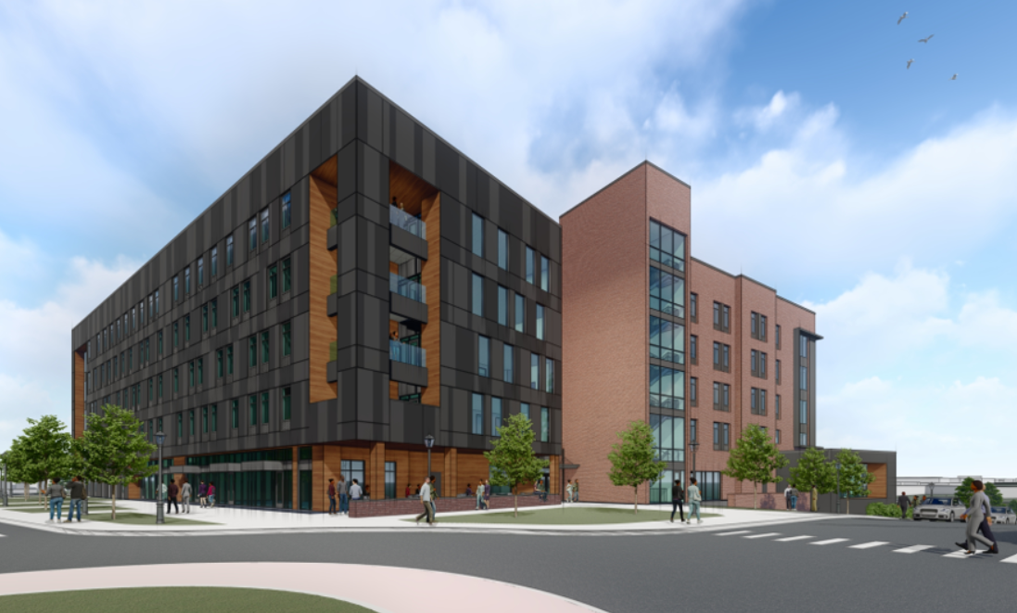
Exciting Year Ahead
413 Suite-Style and Traditional Beds in a five-story complex
$64-million Project
Across from Harrison Auditorium on Bluford Street
Groundbreaking: Fall 2023

Slide 5
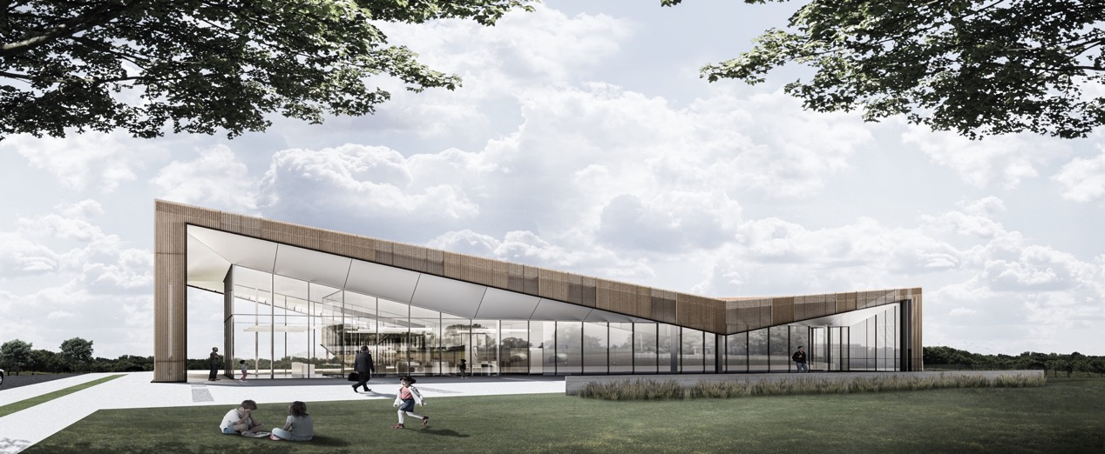
Exciting Year Ahead
University Education & Research Farm
Urban Community Food Processing Complex
$13M advanced test kitchen and development facility
Will include a creamery, where Aggie Ice Cream, other dairy products will be sold
Groundbreaking: Fall 2023

Slide 6
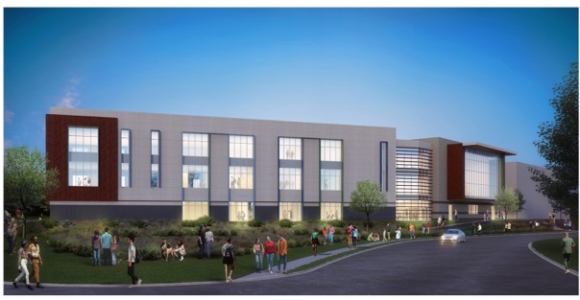

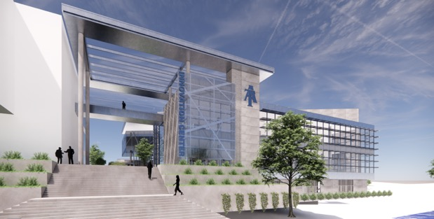

Exciting Year Ahead
Gateway Research Park, South Campus
GCS Community Education Center
$38 Million
Impact Data / N.C. A&T “Dream Center”
$110 Million
Biotechnology Training Center
$1.5 Million
Coming 2024

Slide 7
New & Coming
Degree Programs

Slide 8


Exciting Year Ahead
Programs Enrolling
First Students this Fall
B.S. in Business Analytics
M.S. in Data and Business Analytics
Programs Expected to Begin
Accepting Apps. This Year
M.S. in Physician Assistant Studies
(currently pursuing provisional accreditation)

Slide 9

Exciting Year Ahead
Programs Being Submitted
for BOG Review/Approval
M.S. in Criminal Justice
Ph.D. in Criminal Justice
Ph.D. in Sociology
Ph.D. in Applied Psychology
Doctor of Nursing Practice
Four of these programs are in the College of Arts, Humanities and Social Sciences
Three of them represent that college’s first doctoral programs

Slide 10
A&T’s Development as a Doctoral / Research University

Slide 11
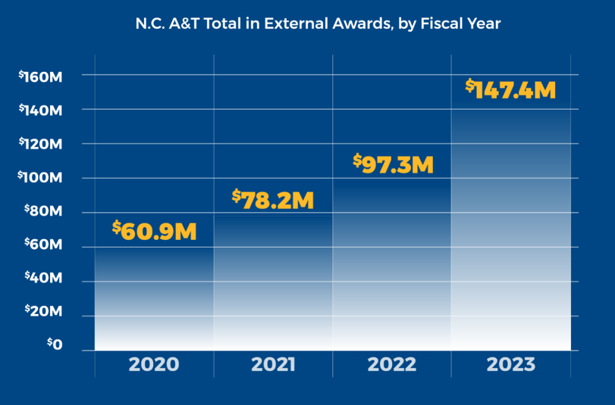
Exciting Year Ahead
Research and Sponsored Programs Awards, FY23
$147.4M – a $50M increase over FY2022 and 138% increase over the past 4 years
Along with Chapel Hill and NC State, A&T is one of the UNC System’s 3 most productive research campuses
Supermajority of awards come from federal agencies, the most competitive arena for scientific contracts and grants

Slide 12
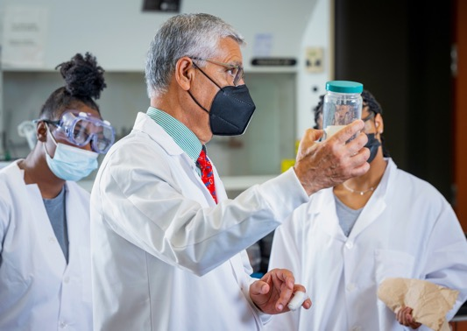
Exciting Year Ahead
The Impact of Research at A&T
A&T faculty are developing national reputations for advanced, high-impact sciences in areas ranging from nanomaterials research, bioengineering, autonomous vehicles, food and nutritional science and more.
Strong research programs improve the student experience by involving students in scientific studies and learning from respected researchers in the classroom.

Slide 13
Exciting Year Ahead
Highlights from Proposed Budget
Doctoral Research University Development
Matching Funds – Cooperative Extension
Health Sciences/Hairston College Building
Marteena Hall Renovation
Engineering North Carolina’s Future Prog.
Financial Aid for Students*
* Largest single line item in the A&T budget
$15 million
$10.7 million
$125 million
$10 million
$2.5 million
$120 million+

Slide 14
Exciting Year Ahead
A&T’s New Economic Impact: $2.4 Billion
A&T’s economic impact has grown by 63% since last measured four years ago
It is now equivalent to support 17,337 jobs across our state
A&T is a leading driver of prosperity in the Piedmont-Triad and across the state

Slide 15
Thank You
Media Availability
Chancellor Harold L. Martin, Sr.
August 23, 2023

