Slide 1
CERT Educational Series
Greg Monty PhD, Vicki Foust PhD, and Elizabeth Keele M.Ed
LIGHT and WAVES

Slide 2
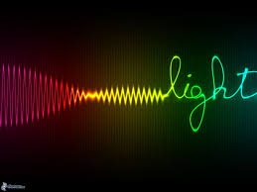
Light Waves, Sound Waves
Light waves transmit energy, NOT MATTER
Waves are moving energy and travel from a source when a vibration is created
These vibrations are carried as “waves” and transmit energy. Light waves are unique because they can travel through a vacuum like space (no material/medium required)
Light waves are called transverse waves while sound waves are called longitudinal or compression waves
Sound waves can not travel through a vacuum!

Slide 3
Transverse Waves, Longitudinal Waves
Transverse Waves:
  Particles move perpendicular to the direction of the wave
Longitudinal Waves:
  Particles move parallel to the direction of the wave

Slide 4
Characteristics of Light
Light waves transmit energy NOT MATTER.
Wave behavior can be described in terms of speed.
Waves have properties:
    Wavelength
    Trough
    Crest
    Amplitude

Slide 5
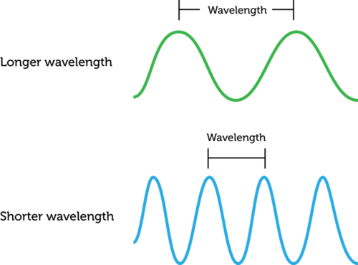
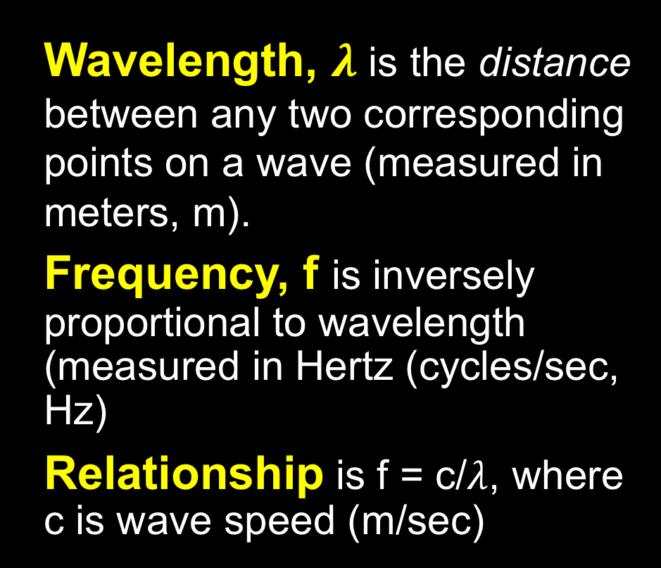
Wave Properties
Wavelength, $λ$ is the distance between any two corresponding points on a wave (measured in meters, m).
Frequency, f is inversely proportional to wavelength (measured in Hertz (cycles/sec, Hz)
Relationship is f = c/$λ$, where c is wave speed (m/sec)

Slide 6
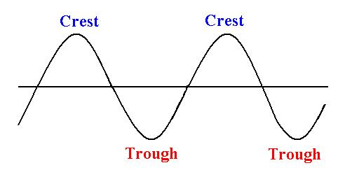
Wave Properties
Crest is the top of the wave, or where the displacement is the highest, or the maximum point.
Trough is the opposite of a crest, where the displacement is the lowest, or the minimum point.

Slide 7
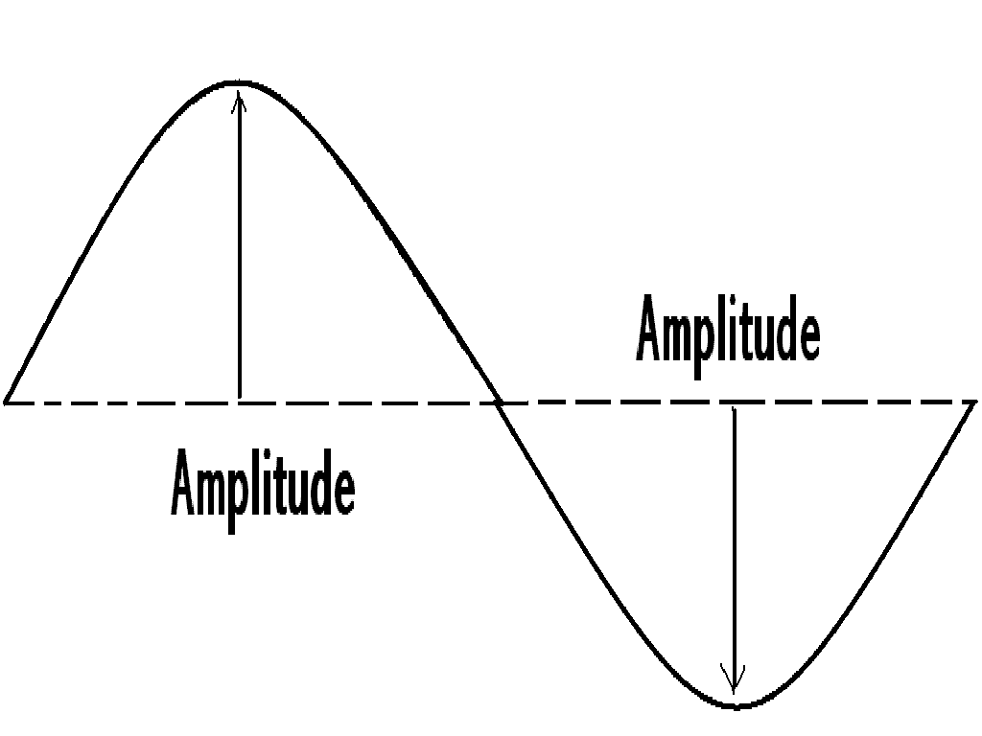
Wave Properties
Amplitude is the maximum displacement from the equilibrium line to the top of a crest, or to the bottom of a trough.
Crest
equilibrium
Trough

Slide 8
Experiment 1: Making a wave
Methodology:
Students will be paired and given a piece of string (by the Teacher)
One student will hold the metal ring still on the top of a desk
The second student will move the string back and forth to create a transverse wave

Slide 9
Experiment 1: Making a Wave
Results:
Write your observations about the waves while teacher collects the strings
And delivers a light meter to your station for Experiment 2

Slide 10
LIGHT INTENSITY

Slide 11
Measuring Light Intensity
Light intensity is measured in Lumens
One Lumen is the total quantity of visible light from one candle
A light meter will be used in Experiment #2
  The unit of measurement for the light meter is LUX
  1 LUX = 1 lumen/m² (see image on next page)

Slide 12
Lumen, Foot-Candles (FC), and LUX

Slide 13
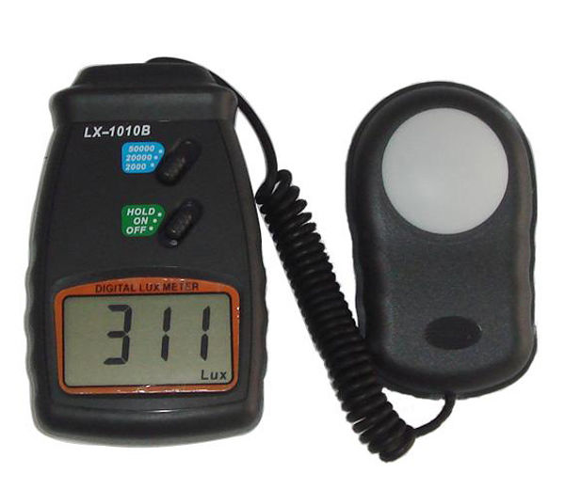
Experiment 2: Light Meter Exploration
Methodology:
Turn on the light meter
Set the meter to 2000
Use the light meter (with cover off): measure LUX in five different areas
NOTE: The meter cannot measure direct sunlight
Set to 2000
Sensor
Turn ON

Slide 14
Experiment 2: Light Meter Exploration
Data Collection:
Record your LUX measurements in your lab sheet, and make note of the surroundings for each of your measurements
Observations:
Record your observations and conclusions in your lab sheet
NOTE: Your teacher will collect all but 8 light meters, and combine students into 8 groups for Experiment #3

Slide 15
TRAVELING LIGHT

Slide 16
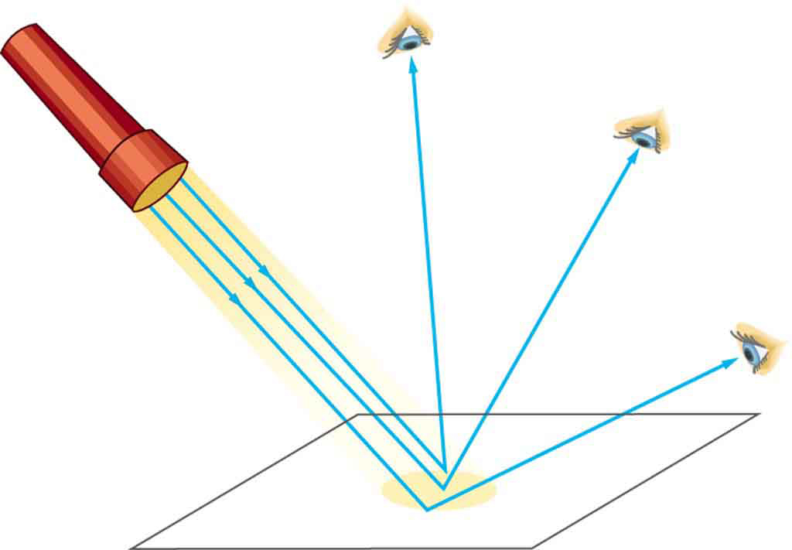
What Can Happen to Light as it Travels From a Source?
Reflected Light is light that bounces off an object.
Mirrors, glass, and metals that are smooth and shiny will reflect light.

Slide 17
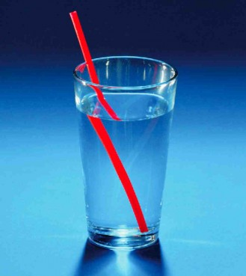
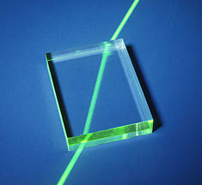
What Can Happen to Light as it Travels From a Source?
Refracted Light is bent when it passes from one object to another.
Refraction is due to a difference
in the density of the two objects.
Higher density materials cause waves to slow down.

Slide 18
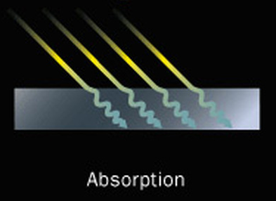
What Can Happen to Light as it Travels From a Source?
Absorbed Light is absorbed by matter, converting the light energy into internal energy (i.e. Heat).
A materials that either reflects or absorbs all light is called Opaque.

Slide 19
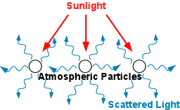
What Can Happen to Light as it Travels From a Source?
Scattered Light passes through an imperfect medium that deflects the light from a straight path. An example is the atmosphere (water particles) that scatters the sun’s rays to produce the blue color in the atmosphere.

Slide 20
Diffraction: Sound does, Light does not (unless the opening is VERY small)
Sound waves can bend around an edge or opening in a wall (long sound wavelengths)
Light waves travel in a straight line, and DO NOT Diffract (until the opening for the light to travel through becomes small: comparable to the wavelength of the light! 300-800nm for visible light)
  Rainbow glasses diffract light because they have a VERY small grid in the plastic lens

Slide 21
Experiment 3: What happens to light as it travels from a source?
Students will be assigned to 8 lab stations, with a light meter
Teacher will distribute 8 Lamps (possibly with extension cords)
Teacher will distribute the following materials in an envelope:
aluminum foil, white paper, black paper, and blue celophane

Slide 22
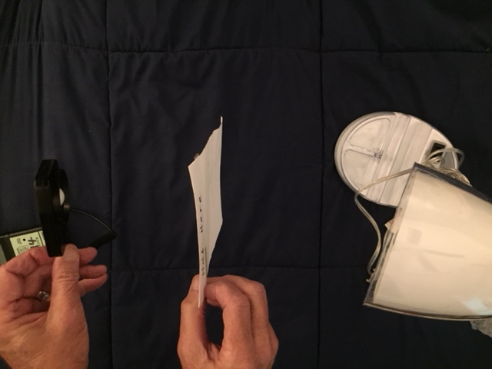
Experiment 3: What happens to light as it travels from a source?
Methodology:
Place light meter sensor about 12 inches from light bulb. Record the reading in the data table in student lab sheet.
Place a piece of aluminum foil about half way between the sensor and the light bulb as shown in the picture
Read the meter and record in the data table in student lab sheet

Slide 23
Experiment 3: What happens to light as it travels from a source?
Methodology (continued):
Repeat measurements with the white paper, black paper, and blue cellophane (between the lamp and light meter). Record readings in the data table in student lab sheet.
Think about reflection, refraction, absorption, and scattering when making your observations.
Your teacher will be collecting the Light Meters, Lamps, Extension Cords, and Envelope of Papers/Materials while you are completing your Lab Sheets.

Slide 24
CONTINUOUS EMISSION SPECTRUM

Slide 25
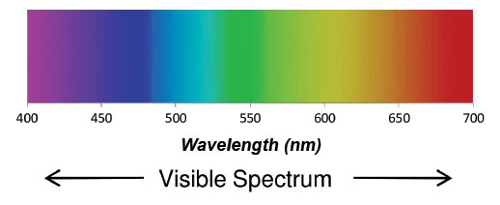
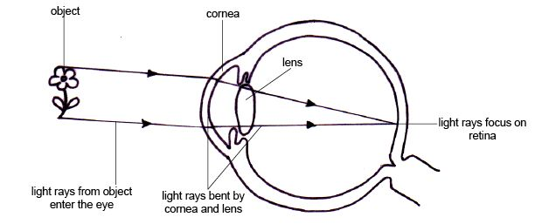
How Do We See the Visible Spectrum?
Object
Cornea
Rods for intensity
Cones for colors
The color of an
object is what
reflects, and is
not absorbed!
Lens
Light Rays focus on Retina
Light Rays from Object enter the Eye
Light Rays bent by Cornea and Lens

Slide 26

This picture has ~16 million pixels where each represents a different color. The human eye can see
~10 million pixels.
The term "pixel" is actually short for "Picture Element." These small little dots are what make up the images on computer displays.
Pixels and the eye

Slide 27
What Do You Know About the Electromagnetic Spectrum?
Electromagnetic Radiation travels in the form of waves covering a wide range of wavelengths and frequencies.
Note: the visible range is a small portion of the electromagnetic spectrum.
The electromagnetic spectrum covers wavelengths of light from long radio waves to short gamma waves.

Slide 28
Electromagnetic Spectrum
Record answers to
Questions in Student
Lab Sheet for Experiment #4
related to wavelengths.

Slide 29
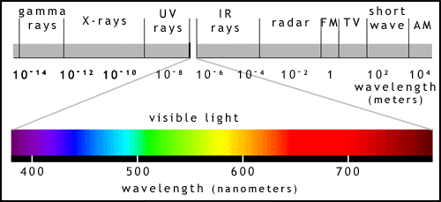
What are the COLORS of the Visible Spectrum?
Higher frequency waves have more energy!
Radio waves are
longer than visible
waves.

Slide 30

Experiment 4: Continuous Emission Spectrum
Methodology:
The teacher will give rainbow
  glasses to each student, and a
  Spectrum Chart to each group
2. A fine grid pattern in plastic lens causes light to diffract into rainbow colors

Slide 31
Experiment 4:
Continuous Emission Spectrum
Methodology:
1. The teacher will turn on ONE LAMP in the front of the class, with the room lights off.
2. Put on the glasses, and look at the lamp
3. Notice all the colors are present and there are no dark spaces between each color. This is called a continuous emission spectrum.
Observations: Record your observations on your lab sheet, and answer the question(s).

Slide 32
IDENTIFYING EMISSION SPECTRA

Slide 33

Emission Spectra
    Each element in the periodic table emits a unique emission spectrum that can be used to identify the element
    An element’s unique spectrum appears in a series of lines called a line spectrum

Slide 34
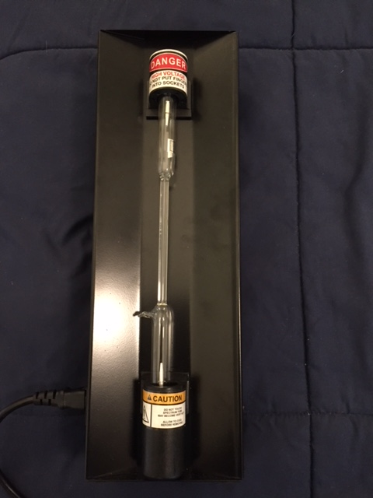
Experiment #5: Emission Spectra
Materials:
Rainbow glasses
Light box (Only teacher will handle power box/tubes)
3 glass tubes containing different elements
NOTE: A glass tube will be placed into the light box. When the power is turned on, the electrons in the gas are excited, move to higher energy levels, and then return to the original energy level. During the transition, visible light is emitted which corresponds to the energy change.
These transitions show up as emission spectra.

Slide 35
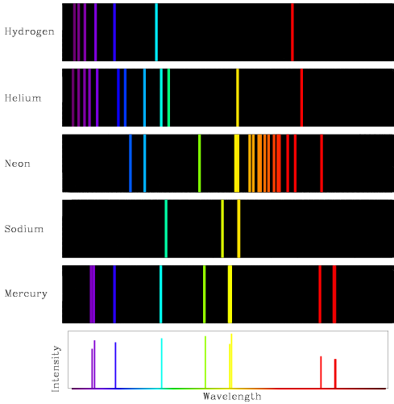
Experiment #5: Emissions Spectra
Hydrogen
Helium
Methodology:
Your teacher will hold up a light box containing an element in a tube
View the tube with your rainbow glasses (room lights OFF)
Review the Spectrum Chart at your station and choose the element that matches emission spectrum
Repeat steps 1-3 for the two additional tubes/elements
Record information in Lab Sheets
Neon
Sodium
Mercury
Intensity
Wavelength

Slide 36
Collect all Module Materials
Your teacher will now collect all the Glasses and Spectrum Charts
If there are any other Light and Waves Module materials at your tables/desks, please give them to the teacher

Slide 37
Thank you for participating in the
CERT Educational Series
Light and Waves

