Slide 1

AIR CLIMATE & ENERGY RESEARCH PROGRAM
B U I L D I N G A S C I E N T I F I C F O U N D A T I O N F O R S O U N D E N V I R O N M E N T A L D E C I S I O N S
www.epa.gov/airscience
Generate!
A game for understanding energy system choices and challenges
Developed By:
U.S. Environmental Protection Agency
Office of Research and Development
1

Slide 2

Energy and its role in air, climate and water
Air Pollutant Emissions
Contributions to U.S. anthropogenic emissions
  Nitrogen Oxides (NO_{X}) ~ 95%
  Sulfur Dioxide (SO₂) ~ 89%
  Carbon Monoxide (CO) ~ 95%
  Mercury (Hg) ~ 87%
Greenhouse Gas Emissions
Contributes 94% of US anthropogenic carbon dioxide (CO₂) emissions
Water Supply, Use and Quality
41% of US water withdrawals (agriculture ~ 37%; public supply ~ 13%)
~200 billion gallons of water per day are required for power plant cooling
Water quality issues for energy resource extraction and processing

Slide 3

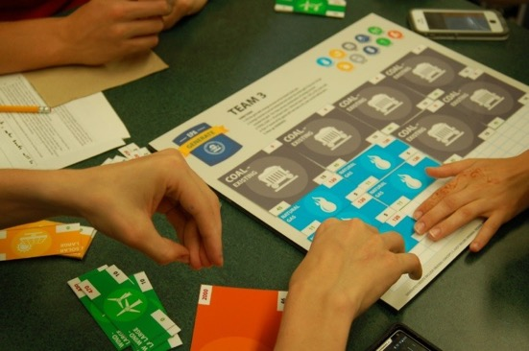
Generate! An Energy Game
“simulation” of an energy system
energy challenges and trade off choices
teams have the same total energy (area of pieces)
teams have different mix of energy pieces
Goal: fill game board to achieve lowest score
Score = purchase cost + operating cost + CO₂ cost

Slide 4
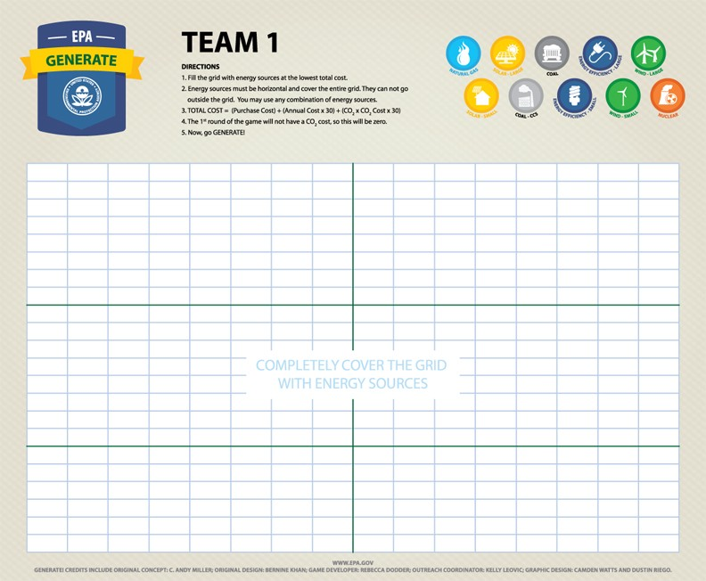
The game board = the “grid”
Students Teams are the decision makers for how they want to produce energy
You will use this board for multiple rounds of game play
Each team can be thought of as a town, state, region or country
Pull out the Notebook, Game board or “grid”, and the Play Pieces

Slide 5
Types of energy pieces
Nuclear
Renewables
Fossil Fuels
Energy
Efficiency

Slide 6




Parts of the energy pieces
What primary energy resource does it use?
How much does it cost to build/purchase?
Size: how much energy does it produce?
How much does it cost each year to run/operate?
How much CO₂ does it produce?
Total Cost = 2125 + (25 * 30) + (0 * 30) * CO₂ Tax
(over 30 years) = 2875
* Units are generic, but represent relative costs of energy sources

Slide 10
Now let’s play Generate!

Slide 11
General Rules of Generate! for all Rounds:
Teams are to completely fill their grids (board) with energy pieces
No overlap
All areas of the grid must be covered, but do not go outside the grid lines
Use the Calculation Support Sheet to guide your strategy for which pieces to use!
Count the number of each piece type and put under Round x on your Team Score Card
Bring your Team Score Card to teacher to record in the Generate Scoreboard for the class
EE or Energy Efficiency pieces will ONLY be used in Round 4!

Slide 12
Round 1 of Generate
The goal of Round 1 is to fill your grid at the LOWEST COST
Note: The CO₂ Cost (carbon tax) for Round 1 is $0/mT
Count the number of pieces of each type and put under Round 1 on your Score Card
PLAY!
12

Slide 13
Round 1 Observation
The goal of Round 1 was to fill your grid at the LOWEST COST
The winning team probably used a LOT of Existing Coal!
Class Discussion
13

Slide 14
Round 2 of Generate
The goal of Round 2 is to find the INCREASE in COST of your grid from Round 1 if there is a carbon tax
Teams are to leave their grid the same as for Round 1
Your teacher will add a $10/mT carbon tax to any generation that produces CO₂ emissions.
Notice how the cost of Generate Scorecard changed for different teams from Round 1?
How did your Round 2 score (cost of energy) change?
PLAY!
14

Slide 15
Round 2 Observation
The goal of Round 2 was to determine the INCREASE in COST of your grid from Round 1 if there was a $10/mT carbon tax
The team that did really well in Round 1 probably didn’t do so well this round!
  Coal has the highest carbon emissions of all generators!
Class Discussion
15

Slide 16
Round 3 of Generate
The goal of Round 3 is to fill your grid at the LOWEST Cost with a $10/mT carbon tax (rearrange your grid)
Use the Calculation Support Sheet to guide your strategy for which pieces to use, considering a $10/mT carbon tax.
Count the number of pieces of each type and put under Round 3 on your Team Score Card
Bring your Team Score Card to teacher to record in the Generate Scoreboard for the class
PLAY!
16

Slide 17
Round 3 Observation
The goal of Round 3 was to fill your grid at the LOWEST Cost with a $10/mT carbon tax.
Teams that used the most Wind, Solar and Nuclear probably scored best during Round 3
  This is because Wind, Solar and Nuclear have zero emissions
Class Discussion
17

Slide 18
Round 4 of Generate
The goal of Round 4 is to fill your grid at the LOWEST COST, but with the addition of ENERGY EFFICIENCY, and $0/mT carbon tax.
Use the Calculation Support Sheet with $0/mT carbon tax to guide your strategy for which pieces to use!
Count the number of pieces of each type and put under Round 5 on your Team Score Card
Bring your Team Score Card to teacher to record in the Generate Scoreboard for the class
PLAY!
18

Slide 19
Round 4 Observation
The goal of Round 4 was to fill your grid at the LOWEST COST, but with the addition of ENERGY EFFICIENCY, and $0/mT carbon tax.
Existing coal and lots of energy efficiency were probably the best combination for this round
Energy efficiency is the “lowest cost” approach for energy generation. If we use less energy, we need or build fewer power plants, and therefore reduce cost and carbon emissions!
Class Discussion
19

Slide 20
That’s Generate!
Thanks for Playing.
Thank you for participating in the
CERT Educational Series

